Slide 1
Data Assimilation in Dynamical Systems Lecture 9
Chris Jones, Amit Apte, Erik Van Vleck

Slide 2
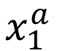
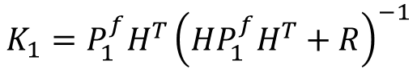
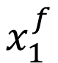
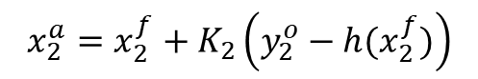
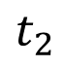
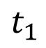
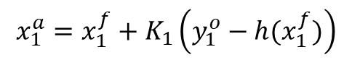
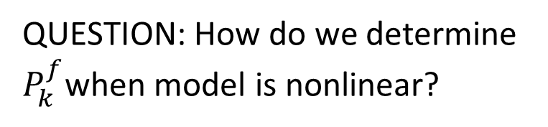
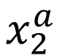
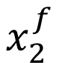
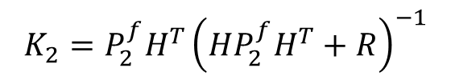
Data Assimilation in Sequential Mode
$$t_{1}$$
$$t_{2}$$
$$x_{1}^{f}$$
$$x_{1}^{a}$$
$$x_{2}^{f}$$
$$x_{2}^{a}$$
$${x_{1}^{a}=x_{1}^{f}+K}_{1}\left(y_{1}^{o}−h(x_{1}^{f})\right)$$
$${x_{2}^{a}=x_{2}^{f}+K}_{2}\left(y_{2}^{o}−h(x_{2}^{f})\right)$$
$$K_{1}={{P_{1}^{f}H}^{T}\left(HP_{1}^{f}H^{T}+R\right)}^{−1}$$
$$K_{2}={{P_{2}^{f}H}^{T}\left(HP_{2}^{f}H^{T}+R\right)}^{−1}$$
QUESTION: How do we determine $P_{k}^{f}$when model is nonlinear?

Slide 3
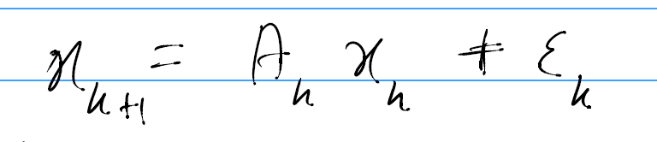
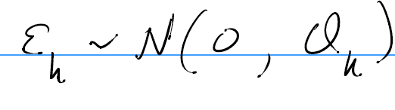
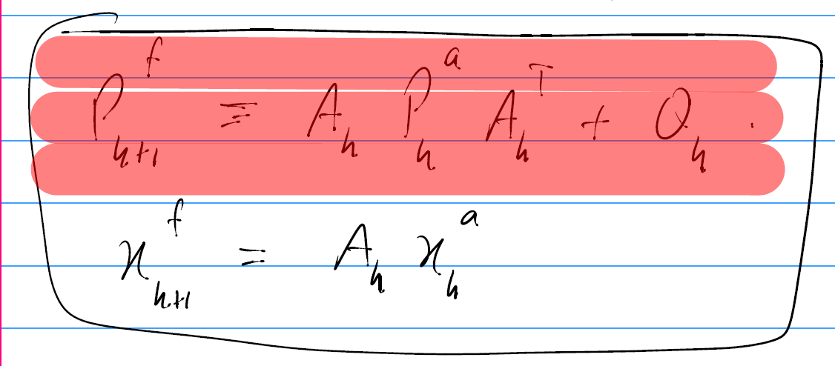

Slide 4
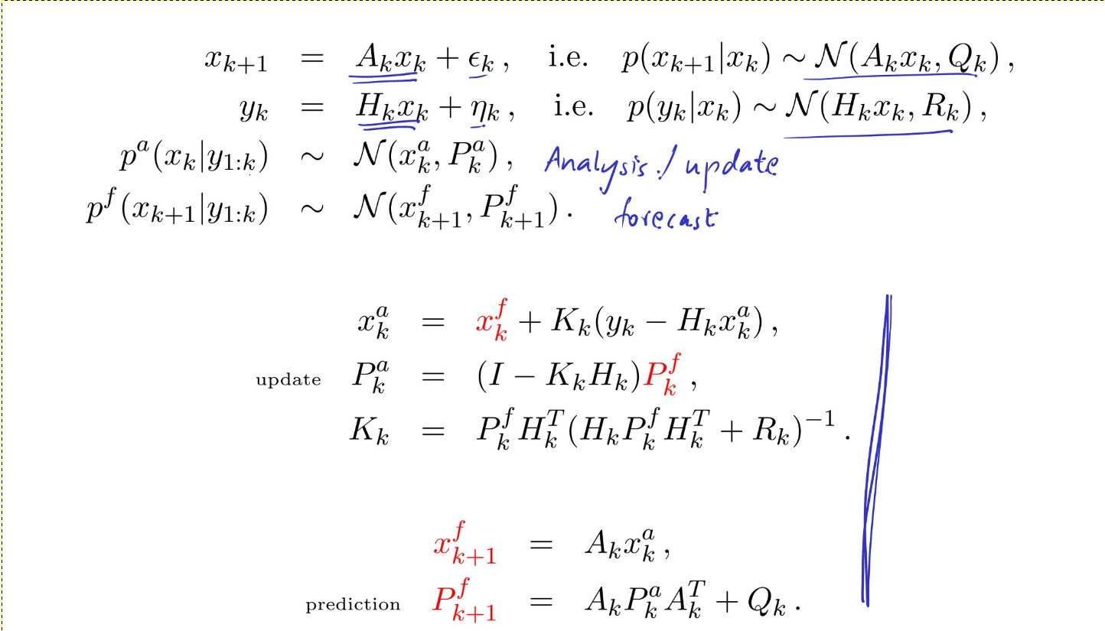

Slide 5
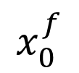
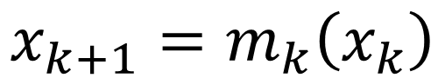
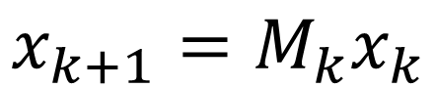
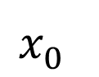
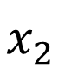
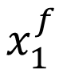
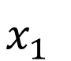
Assume no model error and change notation (out of fear*):
$$x_{0}^{f}$$
$$x_{1}^{f}$$
$$x_{1}^{a}$$
$$x_{2}^{f}$$
$$x_{2}^{a}$$
$$x_{0}^{}$$
$$x_{1}^{}$$
$$x_{2}^{}$$
$$x_{k+1}=m_{k}\left(x_{k}\right)$$
$$x_{k+1}=M_{k}x_{k}$$
* Ide et al.

Slide 6
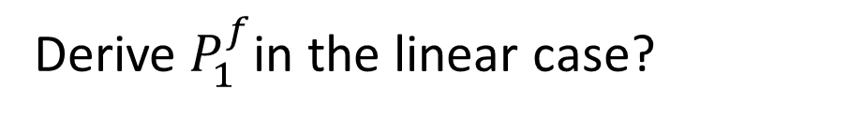
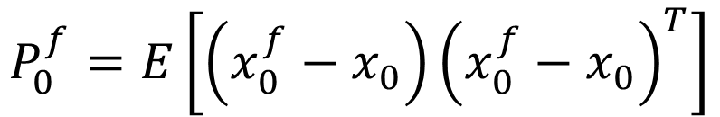
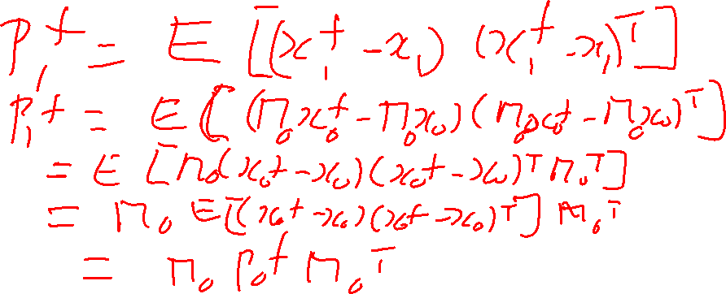
$$P_{0}^{f}=E\left[\left(x_{0}^{f}−x_{0}\right){\left(x_{0}^{f}−x_{0}\right)}^{T}\right]$$
based on confidence in estimate
of initial condition
Derive $P_{1}^{f}$in the linear case?

Slide 7
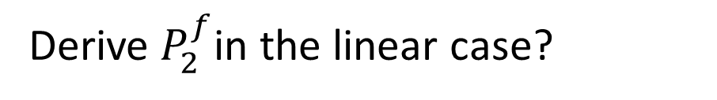
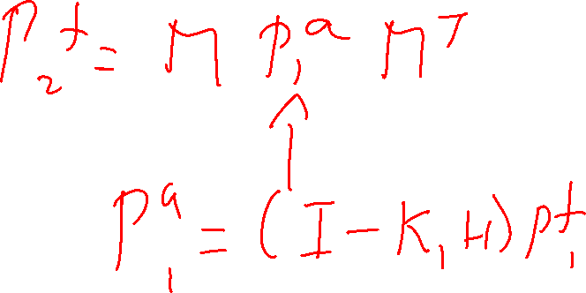
Derive $P_{2}^{f}$in the linear case?

Slide 8
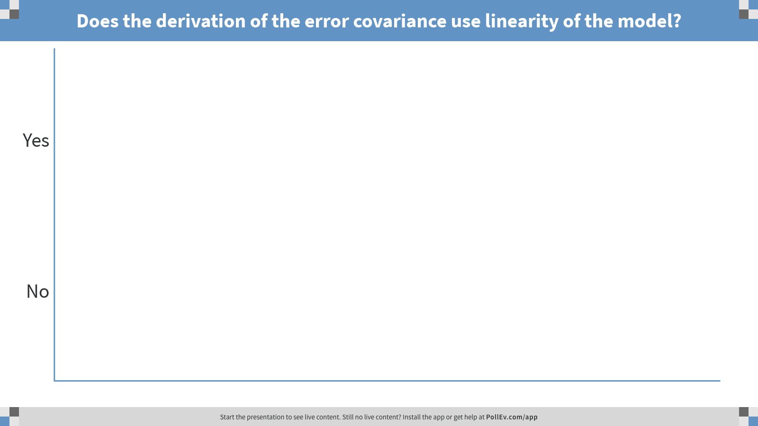
Notes:
Poll Title: Does the derivation of the error covariance use linearity of the model? https://www.polleverywhere.com/multiple_choice_polls/5KGyCtUdTiccnKb

Slide 9
EXAMPLE MODELS:
Lorenz equations
Cellular flow field
Shallow water equations in a box
Linearized shallow water
Primitive eqns of GFD in an appropriate domain

Slide 10
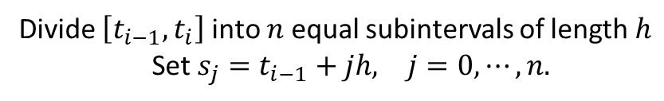
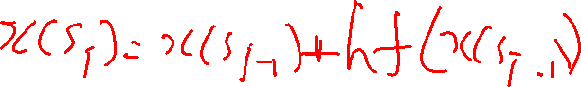
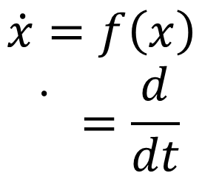
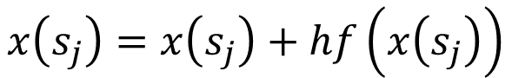
Mathematical model
Computational model
$$\dot{x}=f\left(x\right)$$
$$\dot{}=\frac{d}{dt}$$
Divide $\left[t_{i−1},t_{i}\right]$ into $n$equal subintervals of length $h$
Set $s_{j}=t_{i−1}+jh, j=0,⋯,n.$
$$x\left(s_{j}\right)=x\left(s_{j}\right)+hf\left(x\left(s_{j}\right)\right)$$
(Euler Method)
Note: if external forcing is included then $\dot{x}=f\left(x,t\right)$ and $x\left(s_{j}\right)=x\left(s_{j}\right)+hf\left(x\left(s_{j}\right),s_{j}\right)$

Slide 11
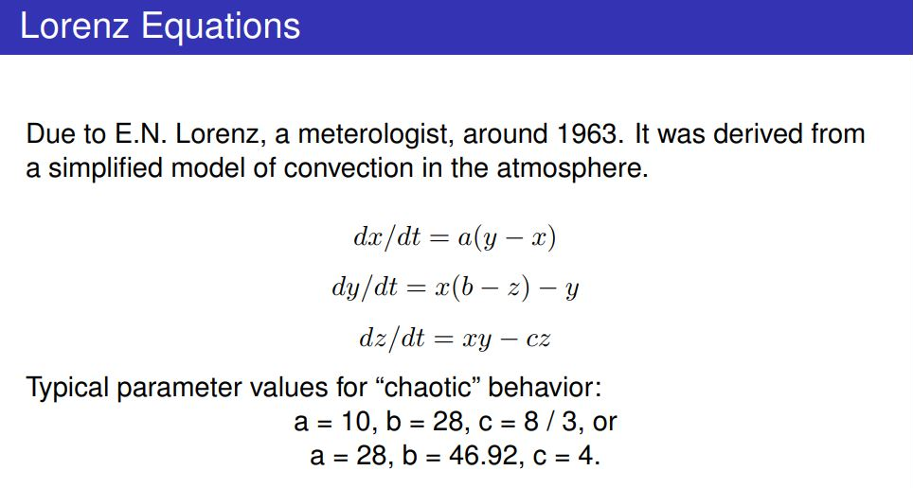
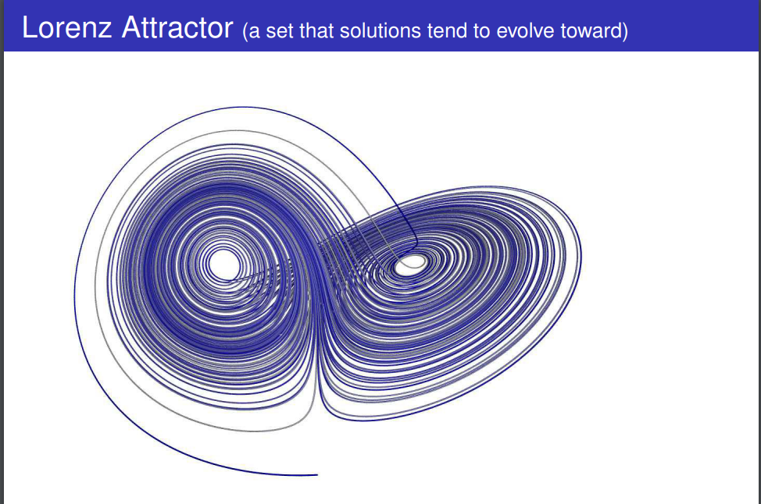
Mathematical model
Computational model

Slide 12
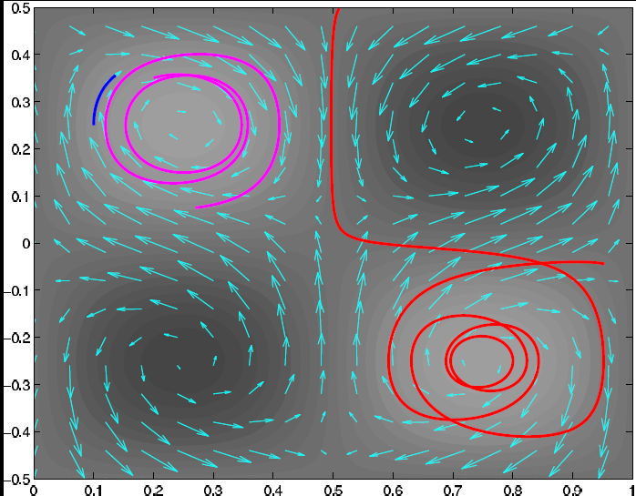
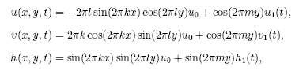
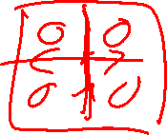
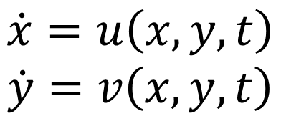
Mathematical model
Computational model
$$\dot{x}=u\left(x,y,t\right)$$
$$\dot{y}=v\left(x,y,t\right)$$

Slide 13
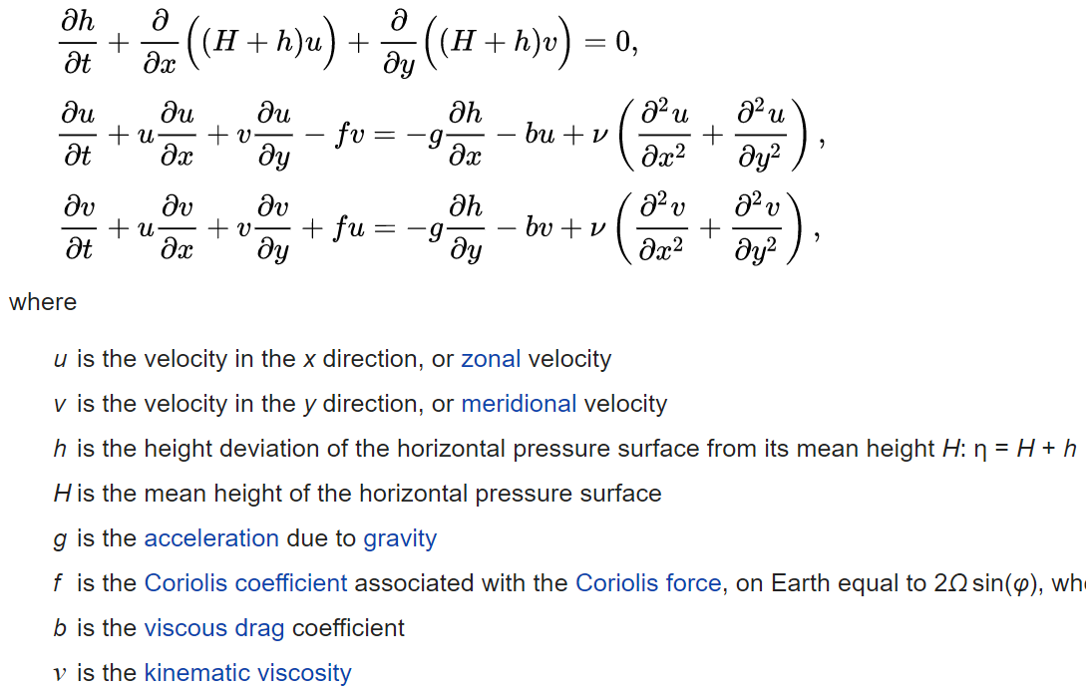
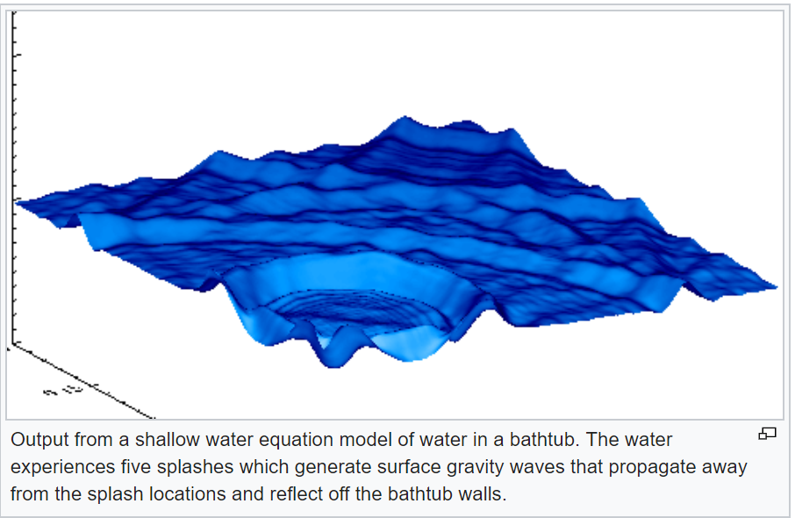
Mathematical model
Computational model

Slide 14
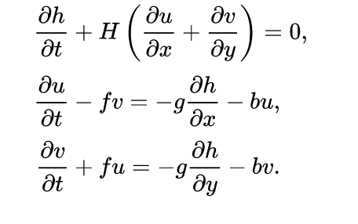
Mathematical model
Computational model
Linearized shallow water equations

Slide 15
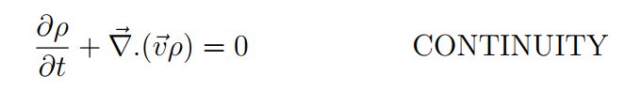
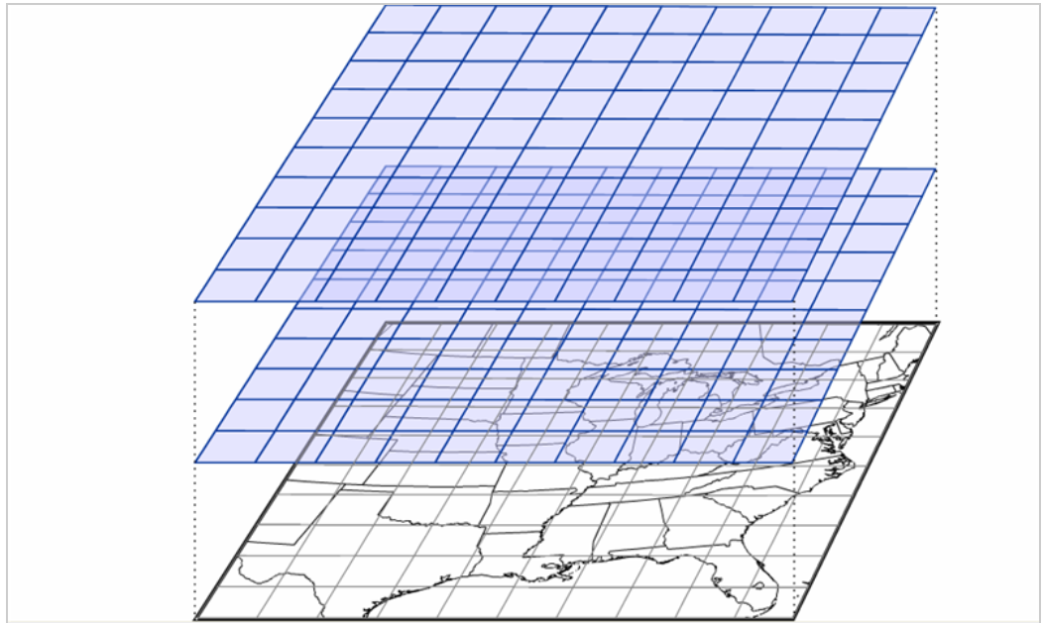
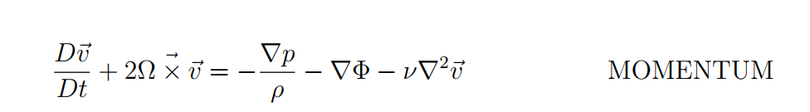
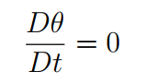
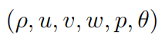
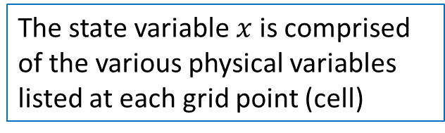
Mathematical model
Computational model
+ gas law
The state variable $x$is comprised of the various physical variables listed at each grid point (cell)

Slide 16
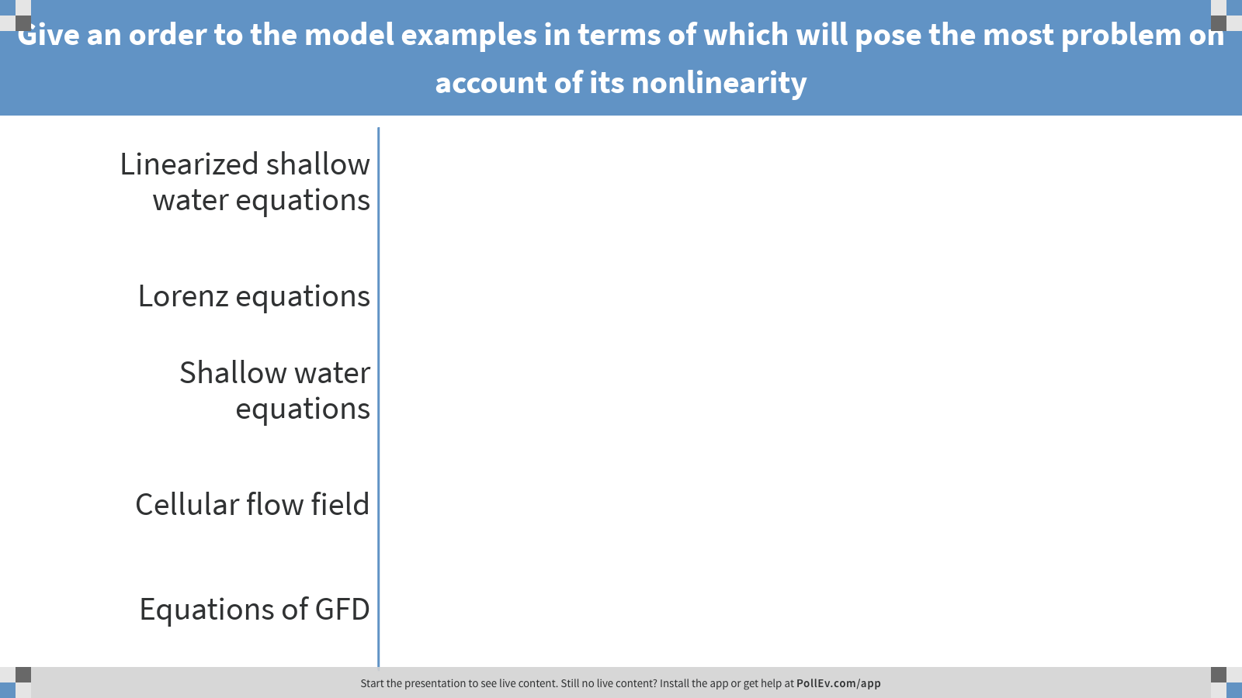
Notes:
Poll Title: Give an order to the model examples in terms of which will pose the most problem on account of its nonlinearity https://www.polleverywhere.com/ranking_polls/LJYH7KYHYSk4QHU

Slide 17
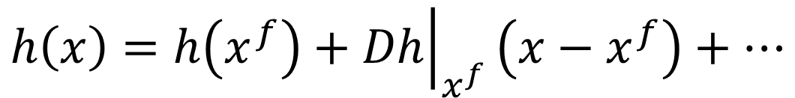
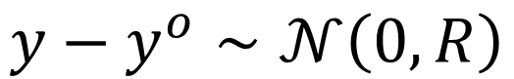







General (nonlinear) observation operator
$$x−x^{f}∼𝒩\left(0, B\right)$$
$$y−y^{o}∼𝒩\left(0, R\right)$$
$$x∈ℝ^{d}$$
$$y∈ℝ^{m}$$
$$H:ℝ^{d}→ℝ^{m}$$
$$h:ℝ^{d}→ℝ^{m}$$
$$h\left(x\right)=h\left(x^{f}\right)+{\left.Dh\right|}_{x^{f}}\left(x−x^{f}\right)+⋯$$
$$x^{a}=x^{f}+K\left(y^{o}−h(x^{f})\right)$$
$$K={BH^{T}\left(HBH^{T}+R\right)}^{−1}$$
$$H={\left.Dh\right|}_{x^{f}}$$

Slide 18




Linearization of Model
$$M_{k}$$
$$x_{k+1}=m_{k}\left(x_{k}\right)$$
$$m_{k}\left(x_{k}\right)=m_{k}\left(x_{k}^{f}\right)+{\left.Dm_{k}\right|}_{x_{k}^{f}}\left(x_{k}−x_{k}^{f}\right)+⋯$$
Derive an expression for the error covariance $P_{k+1}^{f}$ by neglecting higher order terms

Slide 19











Computational model
is determined by solving an ODE $\dot{x}=f(x)$ numerically over the time interval $\left[t_{k},t_{k+1}\right]$
$$x_{k+1}=m_{k}\left(x_{k}\right)$$
$$t_{k}=s_{0}$$
$$t_{k+1}=s_{n}$$
$$s_{1}$$
$$s_{2}$$
$$s_{3}$$
$$s_{4}$$
$$s_{5}$$
$$s_{k−1}$$
Extended Kalman Filter (see Kalnay’s book)

Slide 20


Ensemble Kalman Filter Approach

Slide 21













Analysis step:
Forecast step:
$$x_{k,i}^{f}=m_{k}(x_{k−1,i}^{a})$$
$$m_{0}$$
$$m_{1}$$
$$m_{2}$$
$$x_{0,i}^{f}$$
$$x_{1,i}^{f}$$
$$x_{1,i}^{a}$$
$$x_{2,i}^{f}$$
$$x_{2,i}^{a}$$
$$y_{1,i}$$
$$y_{2,i}$$

Slide 22

Ensemble Kalman Filter
Pdfs are Gaussian
Dynamic model evolution is nonlinear
Patrick Raanes, NERSC

Slide 23
Lagrangian DA (LaDA)
Assimilate data into (fluid) models that comes from instruments that are, at least, partially moving with the flow itself. The data to assimilated may be position only or other physical variables, such as temperature, salinity, pressure etc. measured by the moving instrument.

Slide 24


Floats
RAFOS Floats

Slide 25

Revealing Pathways
Of interest: finding pathways for salty Mediterranean water to reach North Atlantic
Thanks to Amy Bower

Slide 26

ARGO Floats

Slide 27


Drifters

Slide 28

Drifter tracks
DART project: Marie-Poulain et al.

Slide 29

Gliders

Slide 30
Approaches-Lagrangian DA
Convert trajectory data into velocity information via difference quotients (Carter)
Append trajectory equations and implement DA on augmented system (Ide, Jones and Kuznetsov)
Reset velocity field in neighborhood of trajectory measurements (Molcard, Piterbarg, Özgökmen, Griffa and Mariano)

Slide 31
Augmented system
Append equations for drifters (floats)
Apply filtering to augmented system
Ide, Jones and Kuznetsov (2002)
Notes:
We extend the dynamical model by including tracer advection equations.
Flow equations are not changed: tracers are assumed to be passive.
Linearized model operator can be written in a block form as above.
The dimension of the system increases from N to N+L, dimension of P: from N^2 to (N+L)^2.
Is this increase in computational cost justified? In oceanography observations are often sparse, and
L<<N, so the relative increase in dimension may be not too large. Our goal is to understand how much we can gain by carefully treating drifter observations.
The flow does not depend on tracers, but the tracer motion is does depend on the flow – tracers read flow information along the trajectory.
Observation operator corresponding to measurements of tracer positions is linear in this formulation, and Kalman gain matrix has a simple expression. The weights with which the flow variables are updated by observations are given by first N rows of K. These rows are proportional to P^DF: the correlations between the flow and the drifters. This is the only part of the error covariance matrix that we need in the end (but to predict it we need other blocks of P, perhaps some approximations for those can be used).

Slide 32
Gulf of Mexico
3 active layer, reduced gravity
Modeling of the loop current in the GoM
Limited area model
12-20 km

Slide 33
Results: rms(truth-analysis) of interface’s depths
Interface between layer 1 and 2
EuDA (u,v)
LaDA (x,y)
LaDA (x,y,z)
Interface between layer 2 and 3

